Slide 1
CLIMATE CHANGE

Slide 2
Lesson 1 – Weather, Climate & Sun’s Power
What’s the difference between weather and climate?
How does the Sun power the Earth’s Climate?

Slide 3
Weather Versus Climate
WEATHER:
Atmospheric conditions, including temperature, precipitation, wind and humidity, in a particular location over a short period of time

Slide 4
We describe weather with terms like:
Temperature
Type and amount of precipitation
Wind speed
Relative humidity
Atmospheric pressure
Presence of fog, mist, or cloud cover

Slide 5
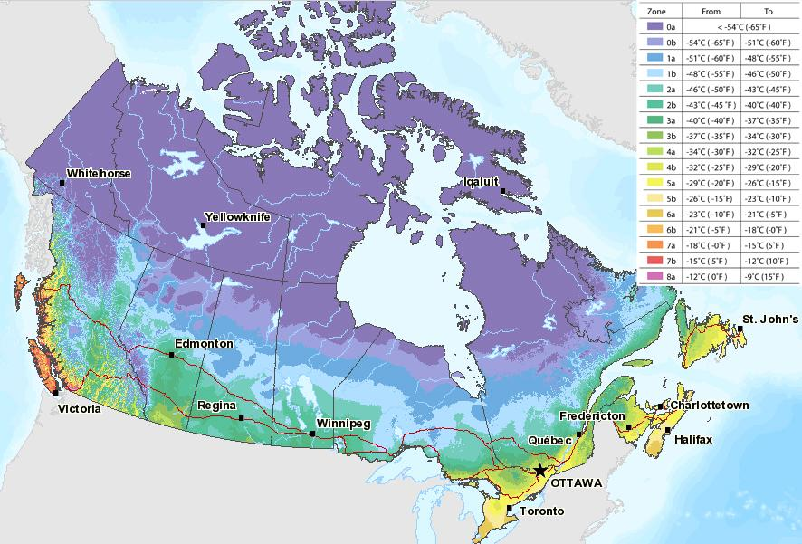
CLIMATE

Slide 6
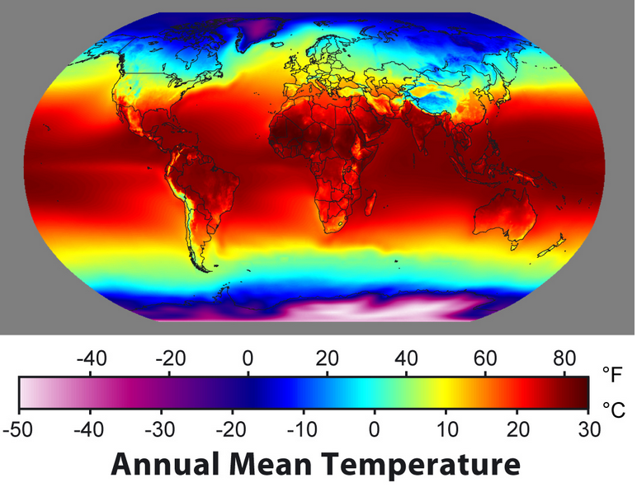
CLIMATE
The usual pattern (the average) of the weather in a region over a long period of time (usually 30 years)
The climate of a region determines the types of plants and animals that live there

Slide 7
CLIMATE

Slide 8
Factors affecting climate:
Distance from equator (latitude)
Presence of large bodies of water
Presence of ocean and air currents
Land formations
Height above sea level (altitude)

Slide 9
Sun & Earth’s Climate System
Climate System
The complex set of components that interact with each other to produce Earth’s climate
These components include:
Atmosphere – (gases surrounding earth)
Hydrosphere – (liquid water, ice, water vapour)
Lithosphere -- (Earth’s rock crust, land surfaces)
Biosphere (Living things) – (plants, animals, microbes etc.)

Slide 10
Sun & Earth’s Climate System
The climate system is powered by the SUN
The energy that Earth receives from the sun interacts with the components of the climate system to produce climate zones

Slide 11
Earth Absorbs Energy From the Sun:
When radiation contacts a particle of matter, one of three things happens:
1. The radiation may be absorbed by the particle, causing the particle to gain energy
2. The radiation may be transmitted through the particle
3. The radiation may be reflected off the particle

Slide 12
Earth’s Energy

Slide 13
Think about this.....
If 70% of solar energy that reaches Earth is absorbed, why doesn’t the Earth just heat up tremendously?
Since the Sun is constantly shining on the Earth and the Earth is constantly absorbing its energy, why does the Earth’s average temperature remain relatively constant?

Slide 14
Think about this....
Notes:
When you put heat on a plate of rocks, eventually the heat will start to radiate off of the rocks. You can feel the thermal heat by placing you hand above the rocks.

Slide 15
Earth’s Surface Emits Energy
As the surface of the Earth warms up from the Sun’s energy, it gains thermal energy and then converts it to low-energy infrared (IR) radiation
The amount of energy radiated by Earth’s system is equal to the amount of energy Earth’s system absorbs from the Sun
Because of this balance of energy, Earth’s global temperature stays fairly constant

Slide 18
Equilibrium...
The balance between energy absorbed from the Sun and energy emitted from Earth ensures that Earth’s global temperature remains fairly constant
http://www.youtube.com/watch?v=DOAqECd70Ww

Slide 19
Equilibrium....
Without a climate system, the Earth would still reach an energy equilibrium, however, Earth would be much colder
The Greenhouse Effect contributes to the Earth not being so cold. Without the climate system’s greenhouse effect, the Earth’s average global temperature would be -18ºC instead of 15ºC

Slide 20
Latitude & Climate Zones
The energy from the Sun is more intense near the Earth’s equator since it hits Earth’s surface directly.
Energy from the Sun is less intense near the two poles since energy hits Earth’s surface at an angle and spreads over a larger area

Slide 21
