Slide 1
Impacts of climate change – globally & locally
Billy Nye Interview Clip:
https://www.youtube.com/watch?v=dkR3TI6xyzU

Slide 2
Impacts of Climate Change
Effects on human society and our natural environment that are caused by changes in climate, such as rises in Earth’s global temperature

Slide 3
IPCC – Intergovernmental Panel on Climate Change
Formed in 1988 to evaluate the risks of human-caused climate change
International scientists share knowledge about climate change (ie: consensus)
IPCC reports identified many potential impacts of climate change

Slide 4
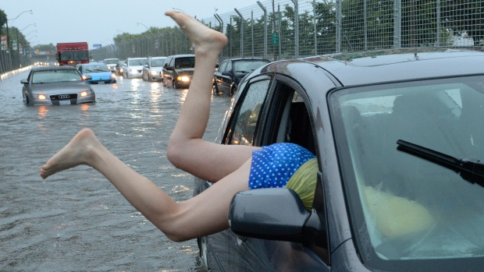
1. Rising Sea Level
Glaciers and ice sheets melting and ocean warming (thermal expansion) will cause sea level of oceans to rise
Lakeshore West in Toronto, July 2013

Slide 5
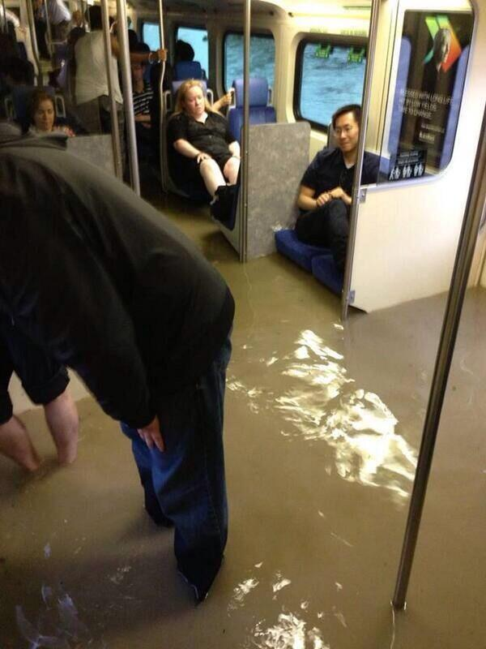
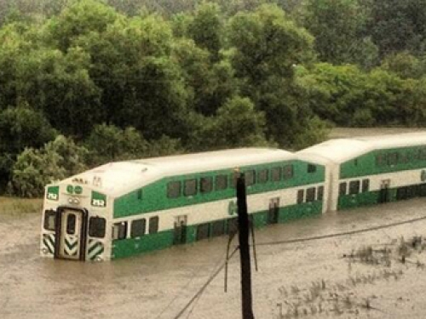
1. Rising Sea Level
This leads to increased risk of flooding

Slide 6
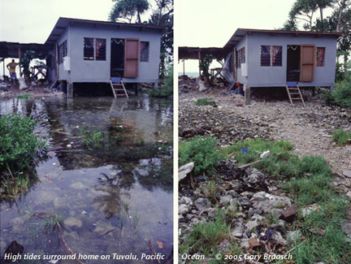
1. Rising Sea Level
Tuvalu, Federated States of Micronesia, Bangladesh, Netherlands, Florida all at high risk of flooding
Tuvalu

Slide 7
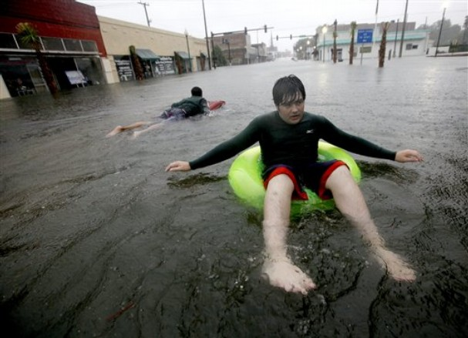
1. Rising Sea Level
Tuvalu, Federated States of Micronesia, Bangladesh, Netherlands, Florida all at high risk of flooding
Florida

Slide 8
2. Impacts on Agriculture
Dry regions (parts of Africa) will get even less water – increased drought
Crops will be less productive leading to famine
Other areas (ex: southern US and Japan) will get increased rain also leading to damaged crops

Slide 9
3. Impacts on Ecosystems
As current habitats become unsuitable, plants and animals will migrate towards the poles – leads to changing ecosystems
Leads to a loss in biodiversity; less biodiversity affects food webs, resources etc.

Slide 10
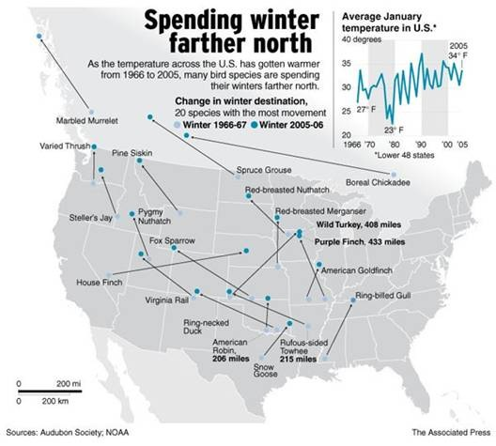

Slide 11
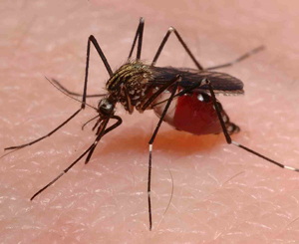
4. Impacts on Human, Plant and Animal Health
Pests, diseases and disease carriers that inhabit warmer climates could spread towards the poles.
Ex: malaria and dengue fever transmitted by mosquitoes, plant diseases, pests that affect crops and forests

Slide 12
Continental Changes

Slide 13
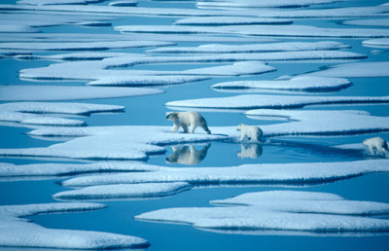
Impacts in the Canadian Arctic
Due to melting sea ice in the arctic, polar bears have limited mobility (ie: polar bears cannot reach their food/seals)

Slide 14
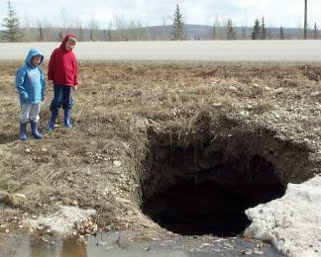
Impacts in the Canadian Arctic
Permafrost (permanently frozen soil) is melting creating sinkholes

Slide 15
Some possible benefits of climate change in the Arctic
Ships can reach the Arctic because of less ice (economic benefit)
Trees are growing in the warmer Arctic climate helping to absorb CO2
Perhaps farms can grow crops in the Arctic
But, are these “really” beneficial??

Slide 16
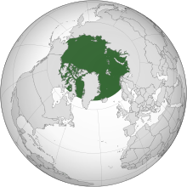
Climate Changes in the Arctic Affect the Rest of the World!

Slide 17
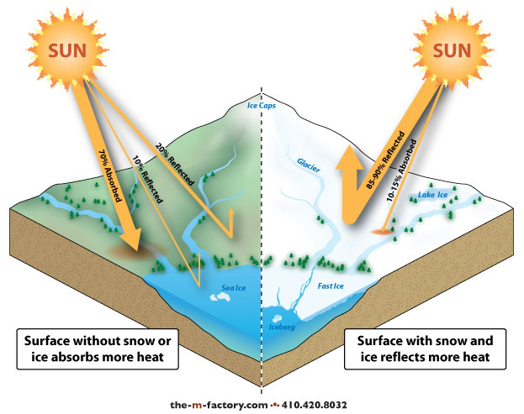
Albedo effect
Less ice in the arctic means less of the Sun’s energy is being reflected back into space

Slide 18
Climate Changes in the Arctic Affect the Rest of the World!
Release of Carbon Dioxide
Carbon dioxide and methane that was stored in the permafrost are being released as it melts

Slide 19
Climate Changes in the Arctic Affect the Rest of the World!
Sea Level
Melting ice raises the sea level
Ocean Currents
Fresh water from melting ice will flow into the Arctic Ocean causing the ocean currents to slow or stop (thermohaline circulation)

Slide 20
Climate Changes in the Arctic Affect the Rest of the World!
Biodiversity
Migratory species with breeding grounds in the Arctic may move to new ecosystems
Shipping and Transportation
As polar ice caps melt, ships will be able to travel shorter routes (less money and energy)

Slide 21
Local Impacts -- Ontario

Slide 22
Ontario’s average temperature could increase by 3 to 6 degrees Celsius in the winter and 4 to 8 degrees Celsius in the summer

Slide 23
Temperature & Precipitation
Winters will be warmer
More rainfall overall, but some areas will become drier while others will become wetter

Slide 24
Changing Lake Levels
Water levels of Lake Superior have dropped significantly over the last few years
Will we see other Lakes also lose water due to evaporation?
Warm lake water leads to fish deaths; increased algae growth

Slide 25
Ecosystems

Slide 26
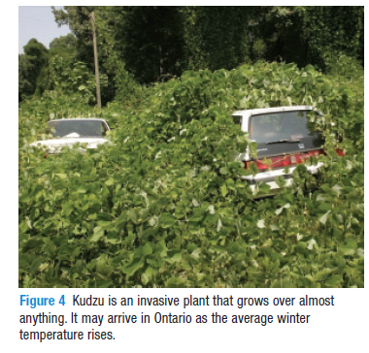
As eco-regions move northwards, we could see the invasion of species that previously weren’t in the ecosystem (ex: Kudzu)

Slide 27
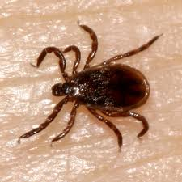
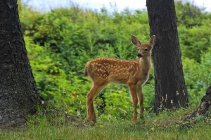
Disease & Illness
Increase in population of disease-carrying organisms (ex: West Nile disease (mosquitoes); Lyme disease (deer ticks))

Slide 28
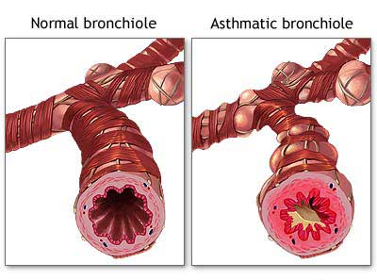
Disease & Illness
Increase in respiratory disorders (asthma etc)

Slide 29
Agriculture
Changes in growing season could be beneficial for soybean and corn farmers, but we could also see growth of unwanted plants
Crops that previously could not have been grown in Ontario, may be able to grow here

Slide 30
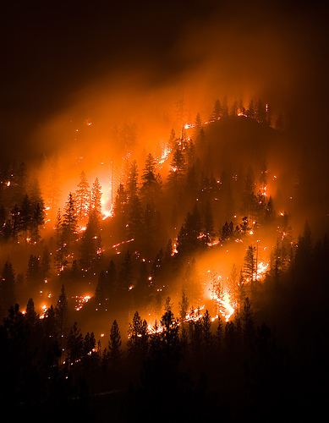
Forests
Hotter, drier summers will lead to more forest fires

Slide 31
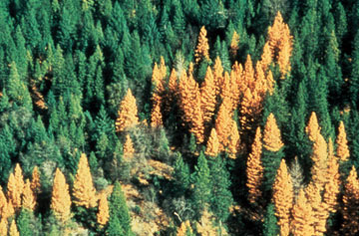
Forests
Increase in insect pests will destroy forests

Slide 32
Forests
As forests become less healthy, they will become a carbon source instead of a carbon sink

Slide 33
Electricity Use
As summers get hotter, we will use more electricity for air-conditioning which will produce even more greenhouse gases
In the winter, energy use may decrease
In Ontario, about ¼ of our electricity is produced using hydroelectric power which does not produce greenhouse gases, but an increase in electricity usage will lead to more blackouts

