Slide 1
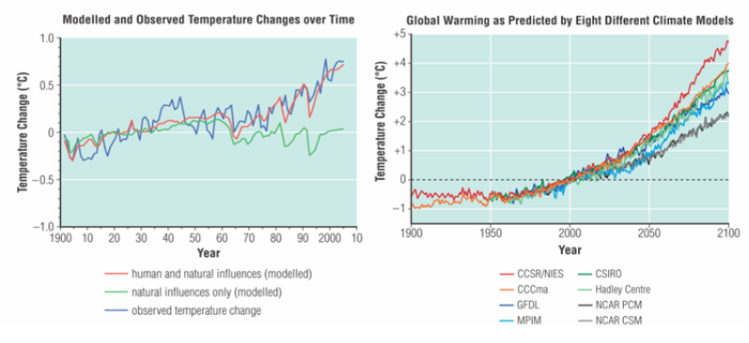
Politics of Climate Change

Slide 2
Political Action on Climate Change
The United Nations Framework Convention on Climate Change (UNFCCC) is an agreement by 192 countries to act to stabilize greenhouse emissions

Slide 3
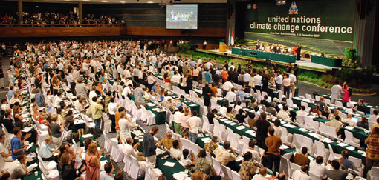
UNFCCC
created in 1992, it enables representatives from different countries to meet to discuss scientific and political action
Each year, the nations meet to discuss climate change strategies. These meetings are called COP (Conference of the Parties)

Slide 4
UNFCCC
The nations that signed the UNFCCC agreed not to hinder food production or economic interests of other countries as well as to support sustainable development within their own countries

Slide 5
Kyoto Protocol - 1997
COP 3 held in 1997 in Kyoto, Japan
Kyoto protocol is a plan within the UN, requiring industrialized nations to reduce their GHG emissions by 5% by 2012

Slide 6
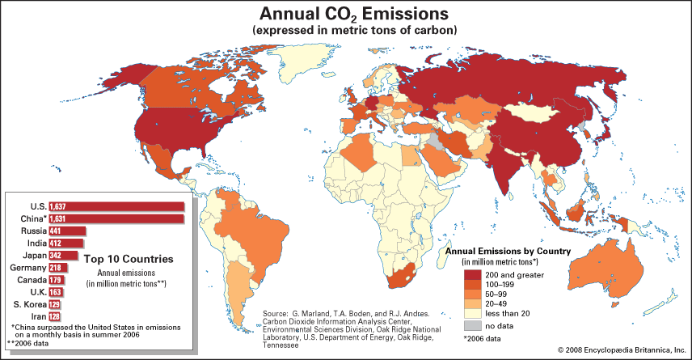
Kyoto Protocol on Climate Change
a UNFCCC agreement originally signed by 161 countries to curb greenhouse gas emissions to 5% below 1990 levels by 2012

Slide 7
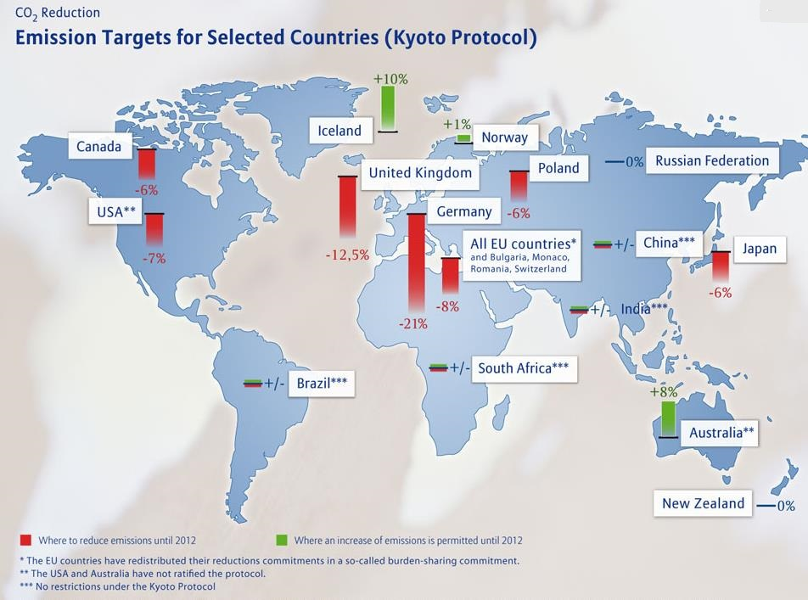
Kyoto Protocol on Climate Change
It went into effect in 2005, as of 2008, 183 countries had ratified it. It outlined a framework in which each country was assigned a target greenhouse gas reduction
USA never ratified the Kyoto protocol
Canada ratified in 2002

Slide 8
Common, but differentiated responsibilities:
Developed countries (US,UK, Canada) have already polluted the atmosphere with greenhouse gases (GHGs) through industrialization. So they’re the one who created/started global warming and all the mess.
While Developing countries (India and Brazil) have started polluting the world only recently.
Therefore, the developing countries such as India, Brazil should share less of the burden of lowering overall emissions.

Slide 9
Common but differentiated responsibilities:
Developed countries (US,UK) should bear more responsibility in fixing global warming because they’re the one more responsible for it.
So, while it is the “Common” responsibility of every nation of this world to reduce Green House Gas emission, there should be some difference between the responsibility given to developed countries and developing countries.
Kyoto Protocol follows that principle and assigns separate responsibilities to the countries.

Slide 10
Kyoto Protocol on Climate Change
Developed countries agreed to higher targets than developing countries

Slide 11
Kyoto – differential requirements
Developed nations (USA,UK), will compulsorily reduce their green house gas (GHG) emission by 2012.
Emission targets were set based on the level of pollution created by each developed nation
Developing nations like Brazil, South Africa,India and China, should reduce GHG emission but not compulsory.

Slide 12
History of Climate Change Negotiations:
http://www.youtube.com/watch?v=B11kASPfYxY

Slide 13
Kyoto Protocol
As an incentive to follow through with the targets outlined in the Kyoto Protocol, countries were offered emission reduction credits for the following:
Helping a developing country reduce its emissions
Helping a developed country reduce its emissions during a temporary economic problem
Engaging in practices that help to remove CO₂ from the atmosphere (eg: planting trees)

Slide 14
Carbon Credits & Trading
Each country is given an emission target quota (1Kyoto Unit = 1 carbon credit = 1 metric tonne of CO2 emitted)
Countries are expected not to emit more than their quota
However, if you need more carbon credits, you can purchase them from other countries who haven’t reached their quota

Slide 15
Carbon Offset Credits
If you are big polluter, you can purchase carbon offset credits
Those who buy offsets are essentially investing in other projects that reduce emissions on their behalf, either because they are unable to do so themselves or because it is too expensive to make their own reductions.

Slide 16
Carbon Offset Credits
One thing to note is that not all carbon offsets are created equal. Because the market is new and largely unregulated, some offsets are unlikely to have any benefit for the climate. This is one reason why carbon offsets have gotten a bad rap.
Good offsets should be permanent and actually reduce GHG emissions that would have otherwise not been reduced without this offset

Slide 17
How does emission trading scheme work:
http://www.youtube.com/watch?v=ReOj12UAus4

Slide 18
Canada & the Kyoto Protocol
Canada agreed to reduce its greenhouse gas emissions to 6% below the 1990 level

Slide 19
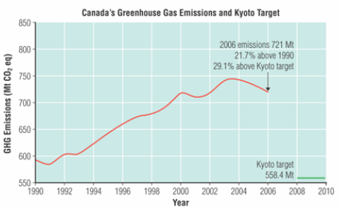

Slide 20
Kyoto Protocol
Between 1990 and 2006, Canada’s greenhouse gas emissions increased by 22%
One reason that we can not make our Kyoto commitment is due to development of the Alberta oil sands
The U.S.A. signed the Kyoto Protocol but never ratified it

Slide 21
Kyoto Protocol
That was then......this is now.....

Slide 22
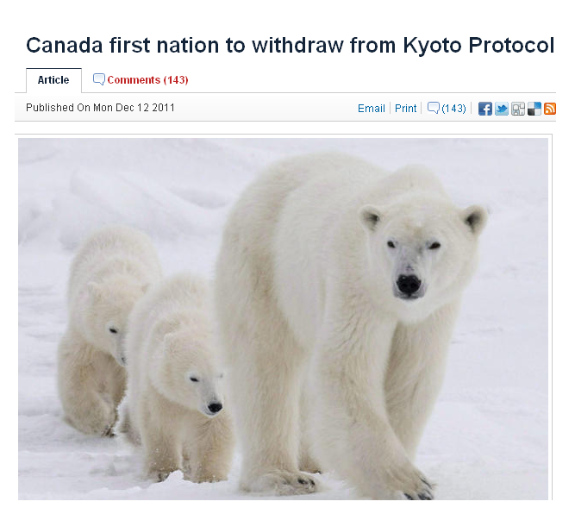
From the Toronto Star

Slide 23
“The Conservative government has pulled Canada out of the world’s only binding climate treaty.
“Canada’s Kyoto withdrawal ‘regrettable’, says China”
“Canada signed Kyoto in the late 1990s, but neither the current Conservative government nor their Liberal predecessors met targets.”

Slide 24
“The Tories have always insisted that meeting Canada’s Kyoto commitments would tank the economy. “
“They have instead set a less stringent goal to lower greenhouse gases that is in line with the United States.”

Slide 25
“The environment minister said the move saves Canada $14 billion in penalties for not achieving its Kyoto targets.”
Kent called Kyoto “radical and irresponsible” and claimed the penalties would cost Canada “the loss of thousands of jobs or the transfer of $14 billion from Canadian taxpayers to other countries — the equivalent of $1,600 from every Canadian family — with absolutely no impact on emissions or the environment.”

Slide 26
RMR – Part of Our Heritage
http://www.youtube.com/watch?v=UHm9qJ7p18s&list=RDUHm9qJ7p18s#t=71

Slide 27
For another point of view… (The National Post)
“Big developing economies such as China, India, Brazil and Indonesia were never given limits. Since they are far bigger polluters than developed nations on a per-dollar-of-GDP basis – China is outright the biggest carbon emitter on the planet – it was always going to be impossible to make substantial reductions in greenhouse gases.”

Slide 28
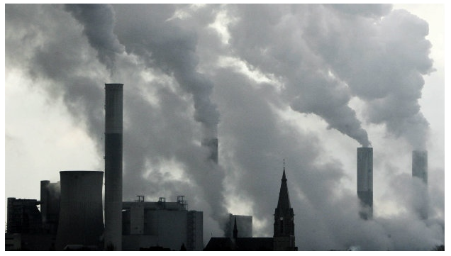
The End of Kyoto 2012

Slide 29
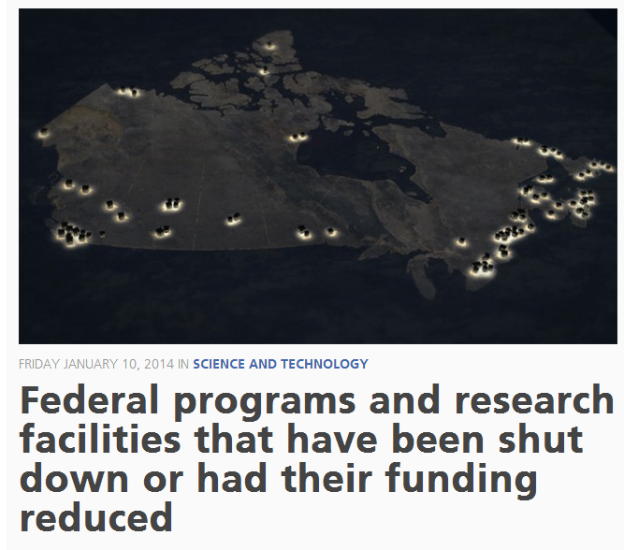
More shame on Canada!!
http://www.cbc.ca/fifth/episodes/2013-2014/the-silence-of-the-labs
http://www.cbc.ca/fifth/blog/federal-programs-and-research-facilities-that-have-been-shut-down-or-had-th

Slide 30
But what do we see?
http://www.youtube.com/watch?v=j0vYTFve7tA

Slide 31
What’s Next? Copenhagen Accord 2013
The Copenhagen Agreement took effect in 2013 after Kyoto expired
Not legally binding
Countries voluntarily made emission pledges
Canada’s commitment is to cut emissions 17% below 2005 levels by 2020
http://www.climatechange.gc.ca/default.asp?lang=En&n=AA3F6868-1

Slide 32
http://www.cbc.ca/news/politics/canada-failing-to-meet-2020-emissions-targets-1.2223930

Slide 33
So, what can WE, as individuals do?!
Reduce your emissions
Try to achieve carbon neutrality by purchasing certified, good carbon offset credits http://www.davidsuzuki.org/publications/resources/2009/purchasing-carbon-offsets/
Be an environmental steward

Slide 34
https://www.ted.com/talks/alex_laskey_how_behavioral_science_can_lower_your_energy_bill
http://www.davidsuzuki.org/what-you-can-do/top-10-ways-you-can-stop-climate-change/

Slide 35
Lessons from Europe
CBC.ca metromorning

Slide 36
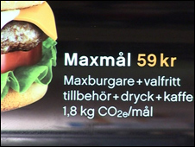
CO₂ emissions labels

Slide 37
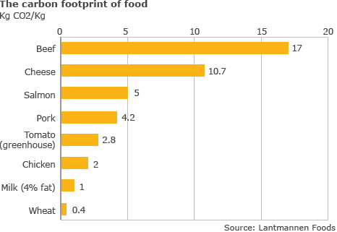

Slide 38
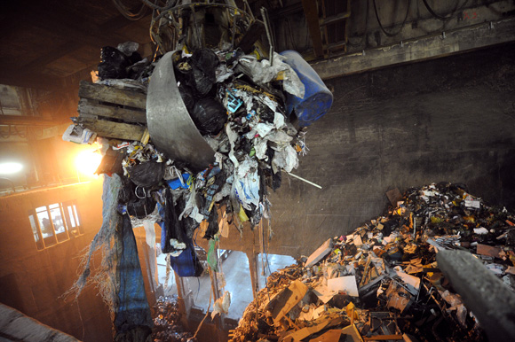
Waste - to - Energy
Stockholm (Sweden) burns garbage to produce heat and electricity.
About half the city is heated by incinerators
Some cities in Sweden and Norway have run out of garbage and are importing from England, Ireland

Slide 39
Waste - to - Energy
When waste breaks down in landfills, it emits methane
Incineration prevents methane from escaping into the atmosphere

Slide 40
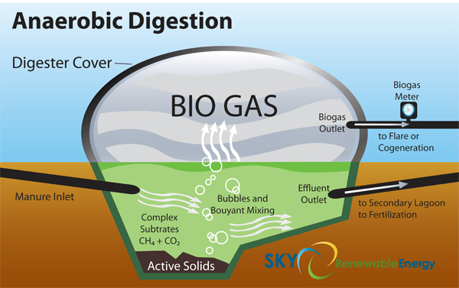
Biogas
produced by breakdown of organic matter without oxygen (anaerobic)
renewable energy source

Slide 41
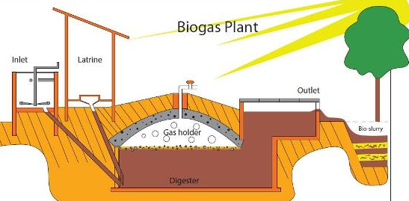
Biogas
produced from manure, sewage, municipal waste, green waste, plant material, and crops.
It is primarily methane (CH₄) and carbon dioxide (CO₂)

Slide 42
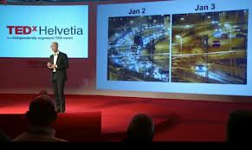
Congestion Tax in Stockholm
The day after congestion tax was introduced

Slide 43
Congestion Tax in Stockholm
Between 6 pm and 6 am travel to the core is free and the rest of the day has a variable amount depending on the time(about $3 during rush hours)

Slide 44
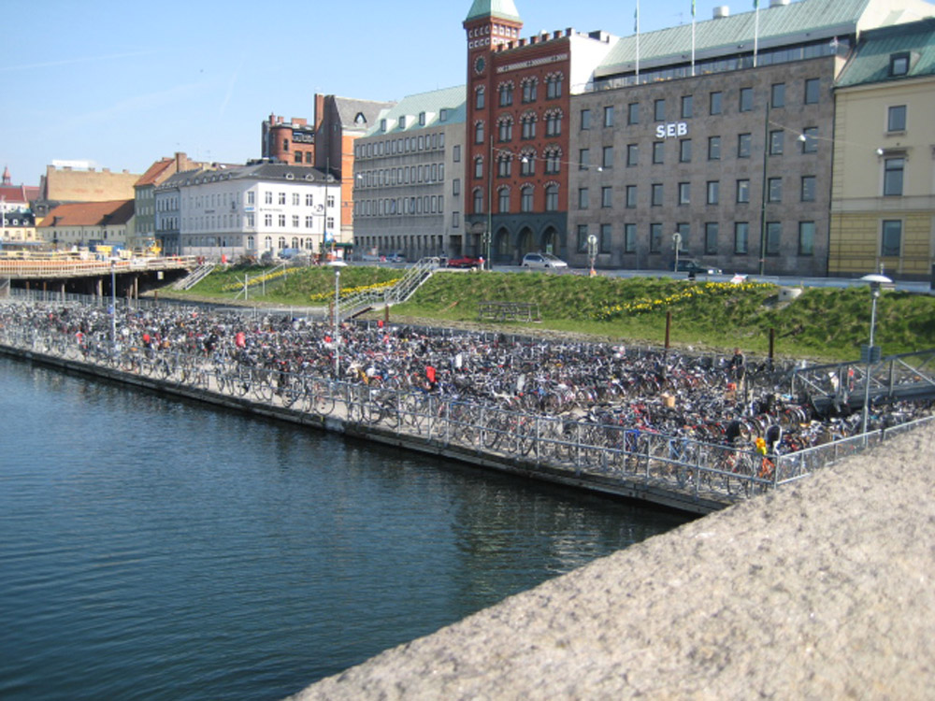
Malmo, Sweden
No Ridiculous Car Trips

Slide 45
Malmo, Sweden
No Ridiculous Car Trips

Slide 46
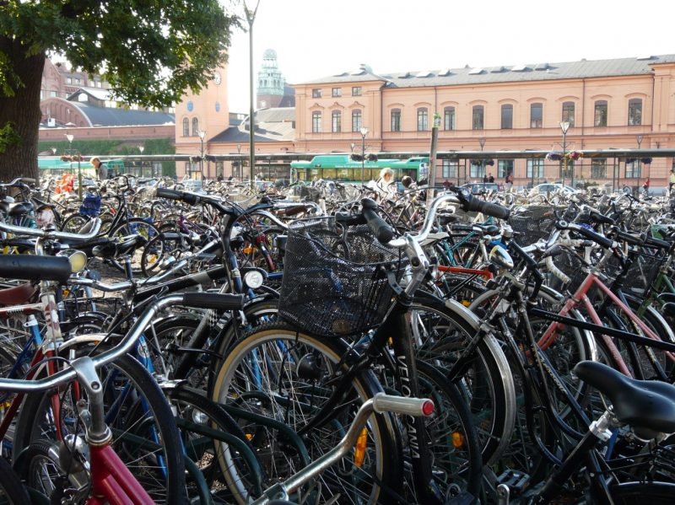
Malmo, Sweden
Parking at a Train Station

Slide 47
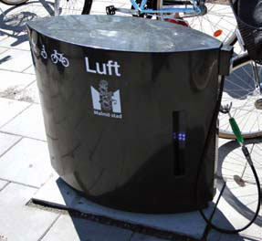
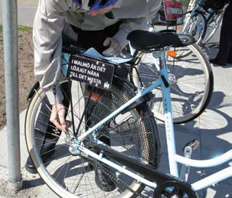
Malmo, Sweden
No Ridiculous Car Trips

Slide 48
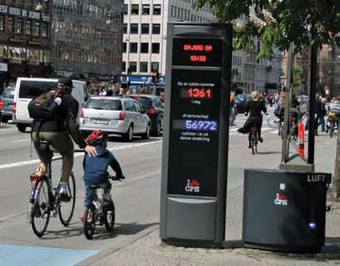
Malmo, Sweden
No Ridiculous Car Trips

Slide 49
Changing Building Codes
All houses in Sweden are required to have more energy efficient windows, insulation, etc. to cut heating costs
Use 25% of the energy we use in Canada to heat a home

Slide 50
Homework:
Read pg. 423-428 #2, 3, 4, 5
Read pg. 429-433 #1, 2, 5, 6, 7, 10
Discuss some REAL, sustainable changes that YOU can make to help reduce GHG emissions. Look online to find some good resources

Slide 51
Resources
Kyoto explained simply: http://mrunal.org/2012/09/enb-kyoto.html#36

